Slide 1
A Steel Market Perspective in a Sea of Uncertainty
February 13, 2019

Slide 2
Today’s agenda
Who we are
Our forecasting methodology
The big picture (macroeconomics)
Current steel price outlook
What we see buying organizations doing
Questions

Slide 3
Who We Are

Slide 5
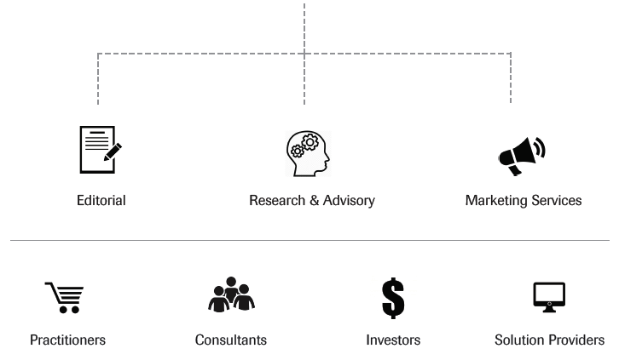
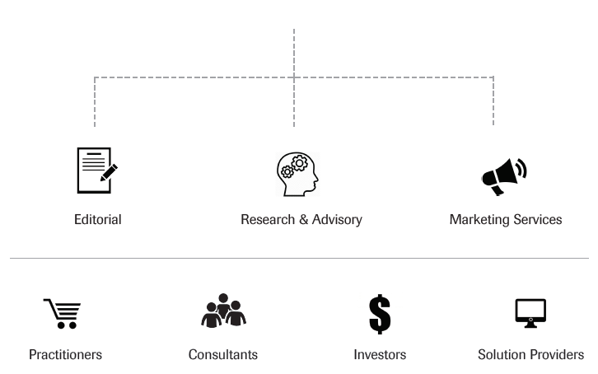
Latest stats…
Largest source of market intelligence for procurement technology and the metals supply chain
2000+ unique companies visit daily
1,400+ subscribers (paid subscribers)
Fortune 500 and Global 2000 audience
50+ free and subscription articles published weekly
Delivering data and intelligence to help companies procure more [cost] effectively

Slide 6
Our Forecasting Philosophy

Slide 7
Our forecasting philosophy
The challenge is not:
Predicting what a specific price will be at a specific time
(If we knew that, surely none of us would be here!)
The challenge is:
Knowing how to source/buy/procure with greater confidence by understanding where the market is and where it could go
And knowing when to change purchasing behavior
By re-framing the challenge, we developed an approach that has been “right” since product inception

Slide 8
The approach
From a short-term or monthly perspective we look at:
Trends of commodities
Industrial metals
The individual metal
Price and volume
From a long-term perspective we look at:
Trends of commodities
Industrial metals
Fundamentals (e.g. supply and demand)

Slide 9
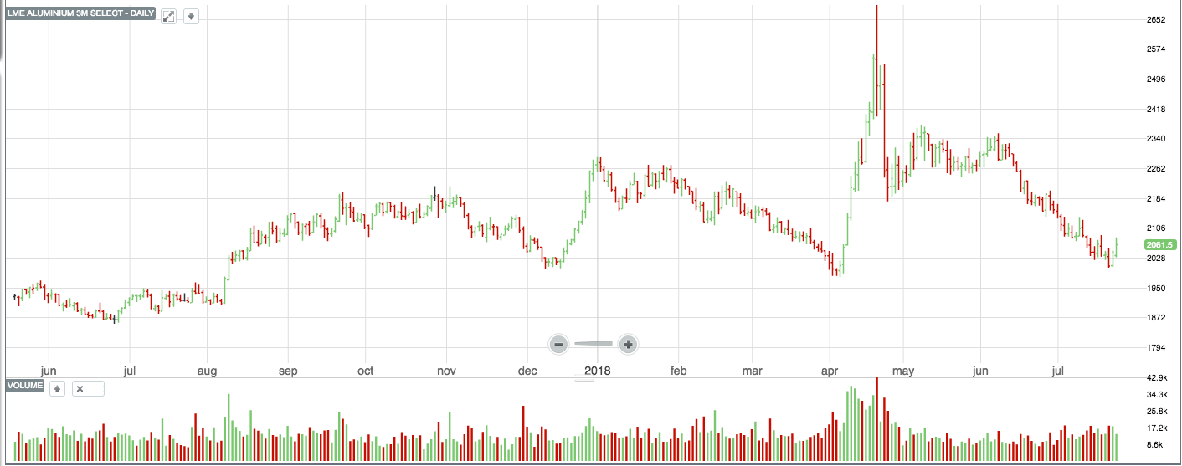
Price and volume
Notes:
Let’s talk about price and volume.
It’s not important to actually make out what we are looking at (it is an aluminum price chart just so you know). The point of this is to take note of these red and green bars at the bottom of the chart. These signify buy and sell volumes.
Green is buy and red is sell.
One of the things that we study involves trading volumes for each of the exchange traded metals. By studying volumes along with price we can determine the “strength of the sentiment”. So it’s not just about looking at the slope of the curve, it’s about looking at the volumes buying into or selling a particular metal.

Slide 10
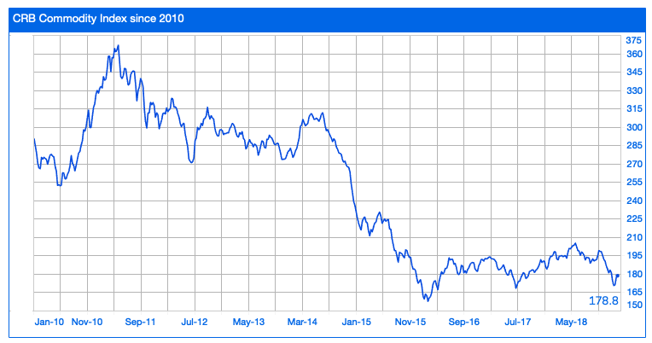
Trends in commodities
Notes:
When we look back at historical data we know that individual metal price trends tend to follow the wider industrial metal index which in turn tends to follow commodities markets. We will take a deeper look at the commodity price trends in a moment.
In addition to the price trend within this index, we also ask ourselves – what is driving this – here we do look at fundamental factors (e.g. supply and demand). For example, here we look at:
Capacity curtailments – think of Chinese steel and aluminum cuts.
China demand (as demonstrated by China PMI, stock market performance, etc)
The dollar (which is proving interesting right now)
December 2018 marks the first time MetalMiner has switched the long-term commodities uptrend to a sideways market trend. This switch in the market, signals commodities have shown weakness. The index contains a number elements, including: energy (such as crude oil, gasoline, heating oil) which have seen price drops; industrial metals and precious metals, also falling; and agricultural products, including cocoa, coffee, lean hogs, live cattle, orange juice, soybeans, and sugar. Only corn, cotton and wheat have seen price increases.
In sum, we place a 40% value on any individual metal’s price on how broad-based commodity markets are doing. Finally, please pay careful attention to the slope of the charts.

Slide 11
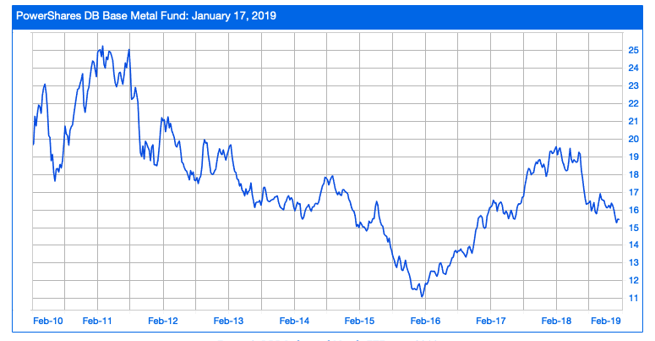
Trends in industrial metals
Notes:
When we look back at historical data we also know that individual metal price trends tend to follow the wider industrial metal index. So when we saw steel prices begin breaking out of their falling price trend in the Dec/January 2018 time frame, we weren’t surprised to see base metals also increase and in fact several of them did all about at the same time.
THE DB index contains zinc, aluminum and copper. And for a long time, this fund under performed relative to the commodity index…basically zinc and tin were the market leaders with nickel not far behind…but then not surprisingly, we saw aluminum, copper and even lead prices start to increase (back in 2017). We weren’t surprised and in fact, were able to advise our subscribers to consider LTA’s and hedging strategies.
In January, MetalMiner shifted its long-term signal for Industrial Metals from Up to Sideways as the index has moved lower and base metal prices have shown weakness.
In sum, we place a 30% value on any individual metal’s price on how the industrial metals complex is doing.

Slide 12
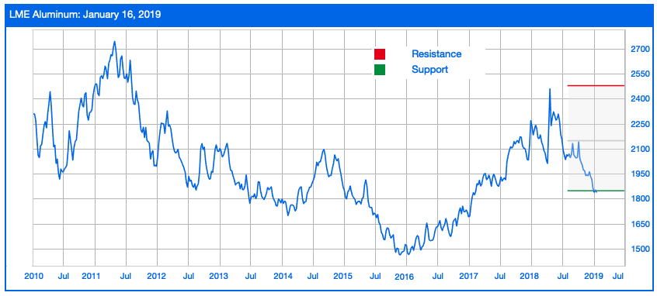
Trends in individual metals
Notes:
So based on where the trend is going for commodities and for the DBB base metal fund, we wouldn’t be surprised to see individual metals also behaving in a similar fashion.
I have picked out aluminum just to show this – I will be covering aluminum shortly.. If we were to chart/show each of the base metals, we would have a couple of exceptions but we will definitely see a pattern of rising prices for 2018.
So after we look at commodity markets and industrial metals as a whole, we can attribute 30% of a metal’s price to what is going on specifically with that metal.

Slide 13
The Big Picture

Slide 14
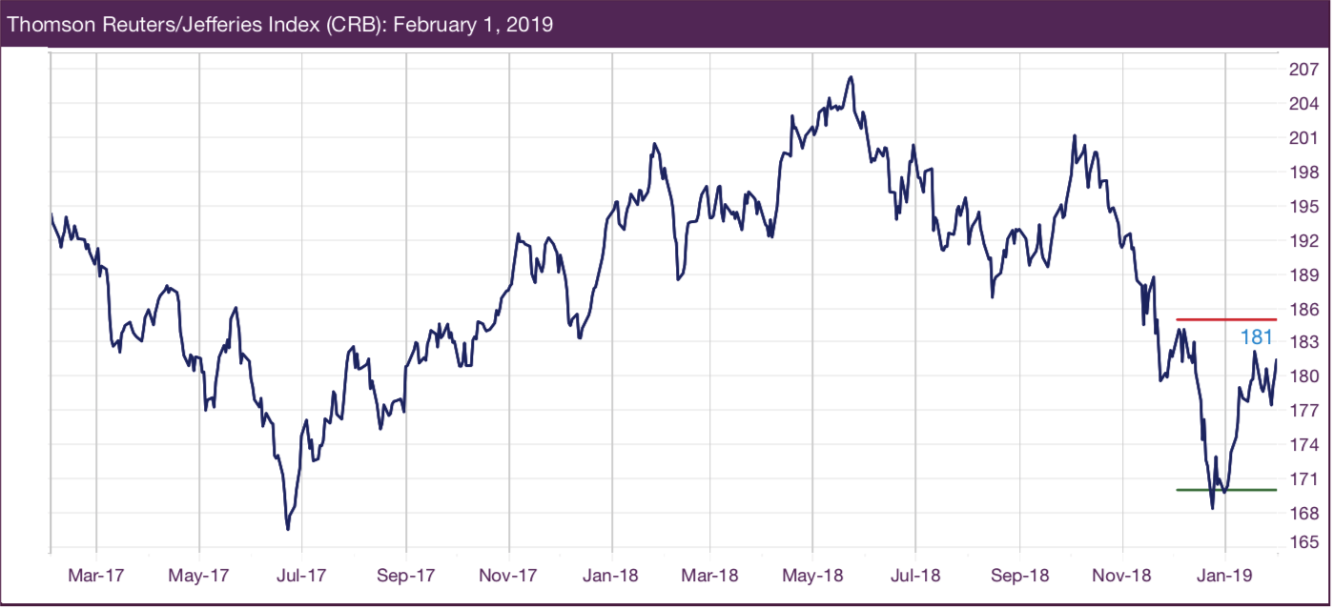
Broad commodity trends
Notes:
The CRB commodity index increased during most of 2018, reaching its latest peak in May at 206. The index has fallen since then, and remains in a sideways trend. In fact, MetalMiner switched to a long-term sideways trend in December 2018, as crude oil prices fell sharply and moved the CRB index low too. The bull market seems to have run out of strength.
Crude oil prices have recovered slightly so far in January, but momentum does not seem to be strong yet.

Slide 15
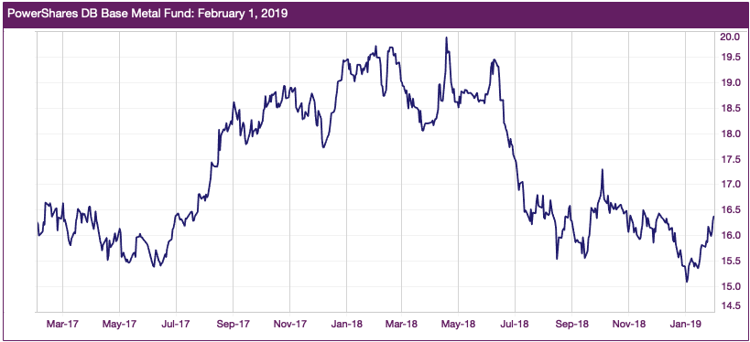
Industrial metals trends
Notes:
The long-term uptrend that started in 2016 in industrial metals has continued throughout much of 2018. During the summer of 2018 the uptrend slowed down, showing signs of a brief pause which is called a short-term sideways trend.
In January of 2019, MetalMiner shifted the long term outlook for industrial metals from bullish to sideways. The recent weakness in the base metals complex together with decreasing global steel prices moved us to consider a slight slowdown in the market.
Base metals traded higher at the beginning of January. However, momentum appears weaker again. The DBB index has shown weakness since June 2018, when it started the short-term downtrend.

Slide 16
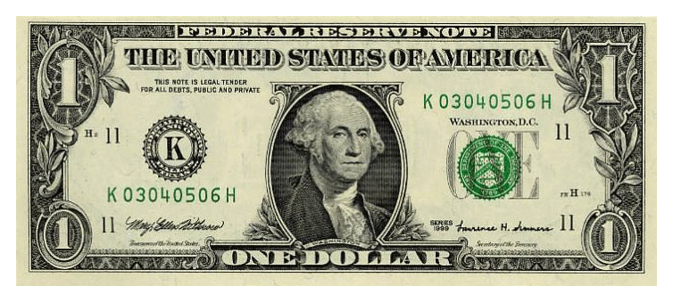
What 3 things impact the long term forecast?
The USD
China
Oil
Notes:
The dollar has made a weak recovery when compared with recent highs in early January 2017 and is oscillating slightly lower than 2015 levels. However, the U.S. dollar remains in a long-term downtrend. Commodities and the U.S. dollar historically move in an inverse relationship.
The Chinese economy appears to be struggling to support growth and deal with tariffs. U.S. and China trade tensions are raising concerns about the strength of Chinese domestic demand for services such as logistics, wholesale trade and trade finance. Trade tariffs, such as the 25% steel tariff, or the Section 301 25% duties on $50 billion worth of Chinese goods are certainly impacting the economy. We will look at this again shortly.
Oil prices have fallen since their peak in October of last year when oil prices breached previous resistance levels. There was a very short term peak in oil prices around October 1st, 2018, at around $75 per barrel, a short-term price resistance point, and then prices dropped off toward the end of the year to $45 and are now around $52 per barrel.

Slide 17
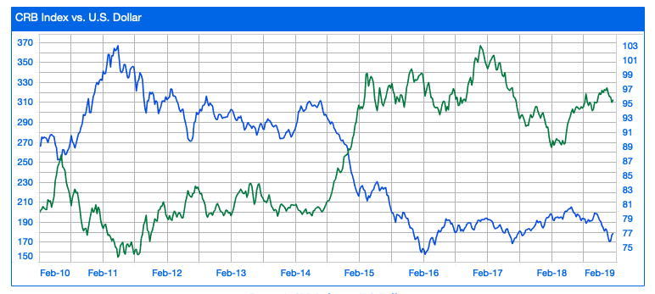
The USD vs CRB
Notes:
The U.S. Dollar and the CRB index historically trade inversely. In 2017, the general dynamics of that inverse relationship between the U.S. dollar and the CRB index changed, resulting in a downtrend for both commodities and the U.S. dollar. However, commodities started the uptrend again in 2018 while the US dollar continued to fall.
The US dollar has been in an uptrend since March 2018, after the tariffs were imposed. Positive sentiment on the U.S. economy caused by tariffs and sanctions led to the higher U.S. dollar. However, the U.S. dollar has yet to show enough strength to breach its resistance level of 98. Therefore, MetalMiner has not called the U.S. Dollar bullish yet and in fact we remain more bearish on the U.S. dollar because the uptrend does not seem to have much strength.

Slide 18
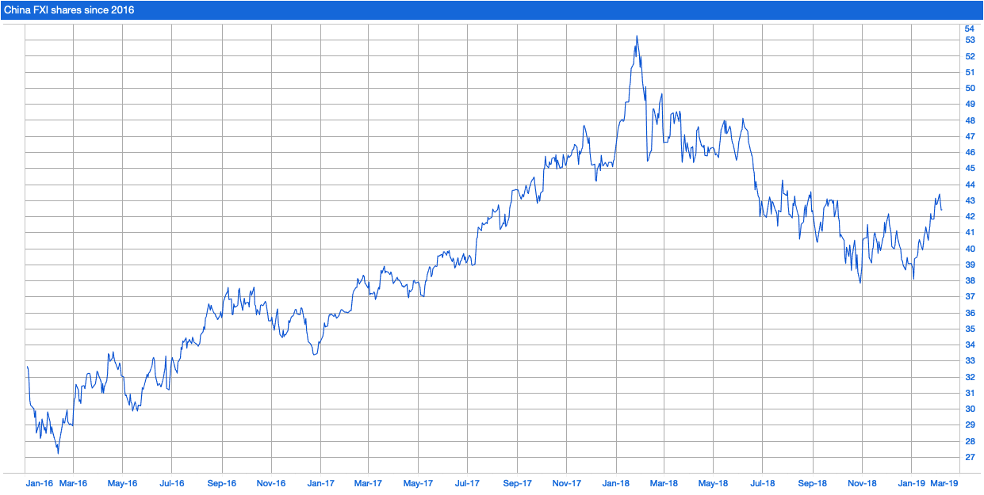
China stock market
Notes:
The Chinese economy grew 6.4% in Q4 2018 year-on-year, falling from 6.5% growth in the previous period, 6.7% in Q2 and 6.8% in Q1.
Overall, the Chinese stock markets may still be in a long-term downtrend but the strong rally so far in 2019 shows a strong sideways movement. However, this should not be seen as a switch in the trend just yet.

Slide 19
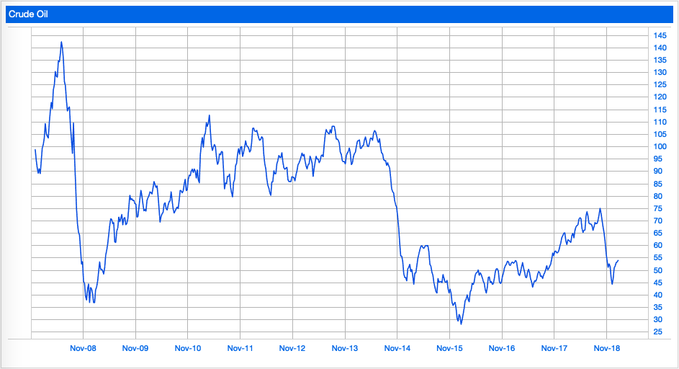
Oil prices – 10 year lookback
Notes:
Oil prices have increased sharply since last September 2017, breaching previous peaks and showing strength. Higher crude oil prices generally support metal prices.
However, crude oil prices oil prices started to show weaknesses at the end of 2018, and have moved into a short-term downtrend. With oil prices below $60/barrel, buying organizations can expect declining crude oil prices. Crude oil prices have recovered slightly so far in January, but current levels do not yet appear strong.
From a technical perspective, MetalMiner adjusted oil price support and resistance levels to $40/barrel and $60/barrel, respectively. With current oil prices at $52/barrel, if prices fall below support levels, some base metals prices, such as aluminum, would also likely fall.

Slide 20
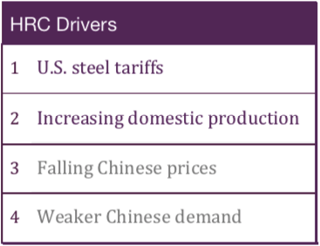
HRC long term outlook
Notes:
Hot-rolled coil prices fell again this month. The downtrend appears sharp, with HRC prices falling back to February 2018 levels (before the imposition of Section 232 tariffs). HRC price momentum continues to weaken, along with the rest of the steel forms. Meanwhile, hot rolled lead times, at under four weeks, remain short. However, we see some additional price momentum and increasing lead times but whether that is enough to change the trend remains to be seen.
Meanwhile, Chinese HRC prices dropped again this month. Chinese HRC prices decreased 3% in December, which means the drop appears less sharp than the 9% fall in November, and kept falling in January. Chinese steel prices seem to have lost momentum as the winter season starts. Chinese steel prices appear to have recovered slightly toward the end of the month, driven by Beijing stimulus measures.

Slide 21
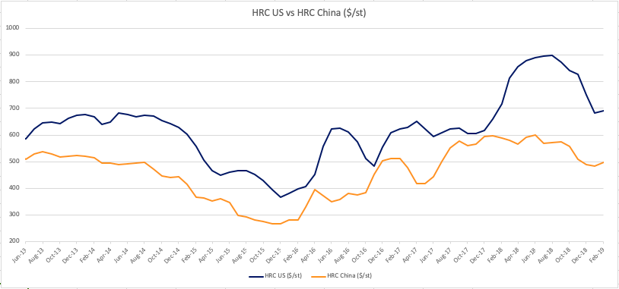
HRC US vs China HRC
HRC US vs HRC China ($/st)
Notes:
Here is the U.S. HRC price in blue and in orange we have the HRC China price for comparison

Slide 22
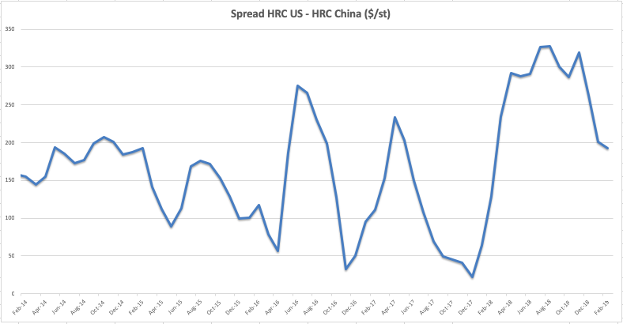
Spread HRC US vs China HRC
Spread HRC US – HRC China ($/st)
Notes:
Here is the Spread between the U.S. HRC price and HRC China price for comparison since 2014.

Slide 23
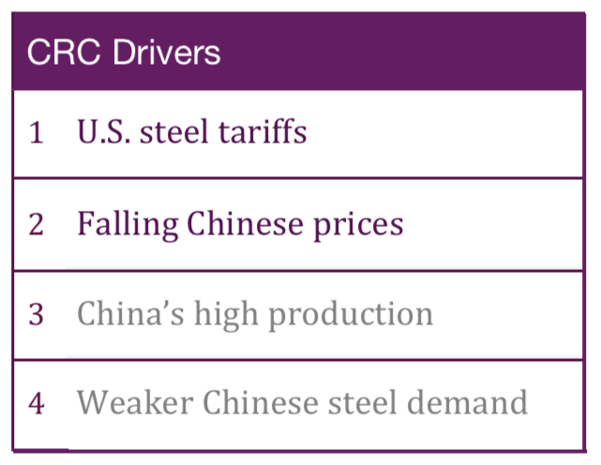
CRC long term outlook
Notes:
Similar to HRC prices, cold-rolled steel prices dropped again in December, following the previous five-month downtrend. The fall appears less sharp this month, as CRC prices increased slightly at the beginning of the month. In the short term, MetalMiner expects domestic steel prices to continue to fall. Meanwhile, cold rolled lead times have fallen to under six weeks.
Chinese CRC prices also fell this month. Chinese CRC prices fell more sharply this month, decreasing by 7%. Chinese steel prices have showed slowing price momentum since October. Weaker domestic demand has caused Chinese prices to fall. The spread between the U.S. domestic HRC price and the CRC price stands at $111/st, inside historical levels.

Slide 24
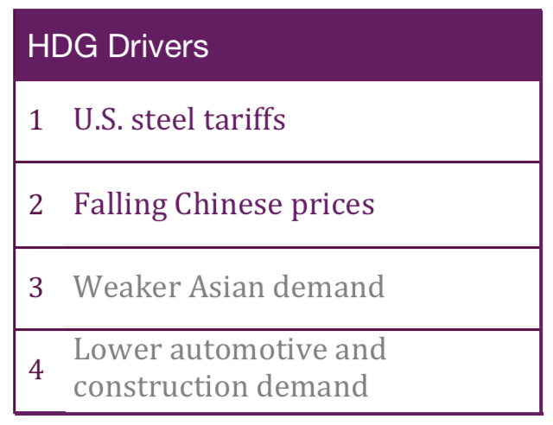
HDG long term outlook
Notes:
HDG prices also fell this month. The decrease in prices appears sharp, and current levels have fallen to February 2018 levels (before the Section 232 announcement). However, lead times for HDG remain close to seven weeks; those lead times have increased recently, but remain below June’s peak levels.
Meanwhile, Chinese HDG prices fell again in December. The drop appears sharper this month, with a 6% decrease. Back in October, Chinese HDG prices increased and only fell 1% in November.

Slide 25
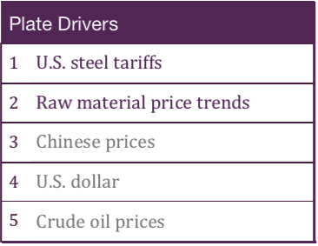
Plate long term outlook
Notes:
Plate prices decreased this month, falling after last month’s small recovery. Plate prices have shown strength; prices remain supported, mainly due to low product availability. Buying organizations may want to remember plate prices tend to follow a trend and move in one direction.
Chinese plate prices continued to fall this month, dropping 6%. Chinese prices have shifted from the previous short-term uptrend, driven by strong demand and environmental curbs beginning in the winter season. Weaker Chinese demand has moved Chinese steel prices lower.

Slide 26
What We See Buying Organizations Doing for 2019

Slide 27
Strategies being deployed by buying organizations
Alternative country sourcing (to mitigate tariff risk)
Alternative domestic sourcing
Group buys/aggregated purchases (e.g. aluminum)
More arbitrage buying
More make vs. buy analyses
Increased use of should-cost modeling
More interest in sourcing stainless globally

Slide 28
Intelligence as Negotiation Leverage

Slide 29
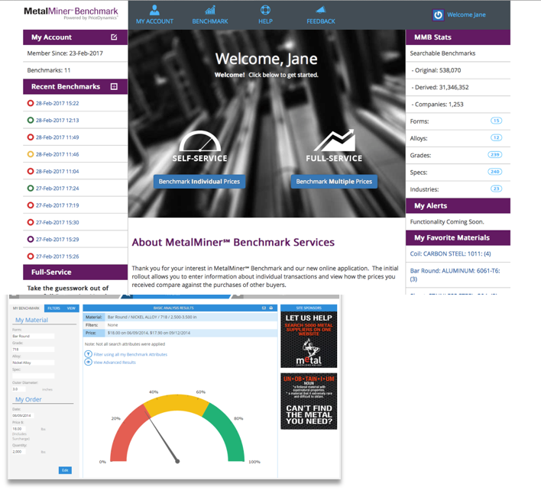
Forecasting, Benchmarking, Aggregated Purchases Contact: lreisman@metalminer.com
Notes:
If you are interested in our February Monthly Outlook report, find me and give me your business card and I will send you a complimentary copy.

